Slide 1
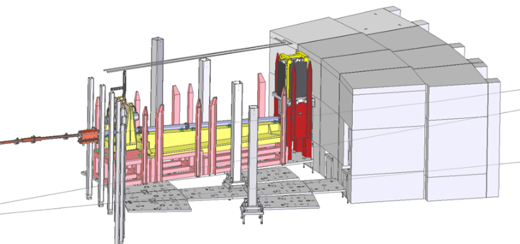
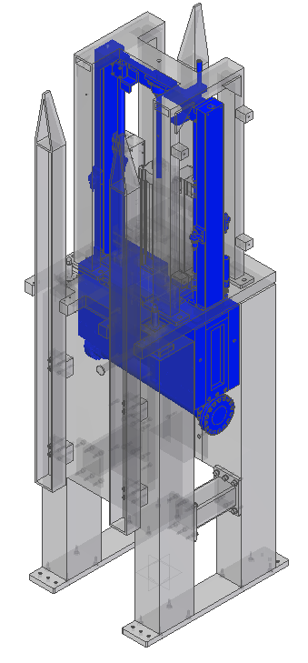
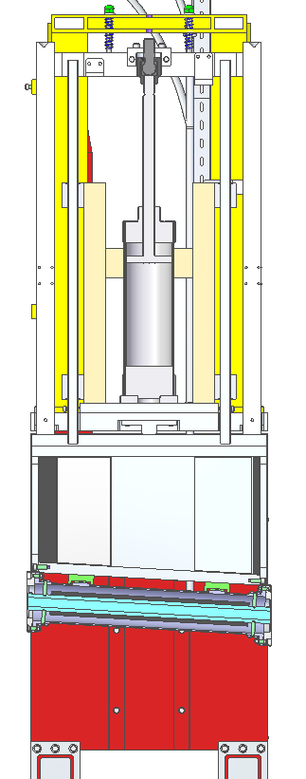
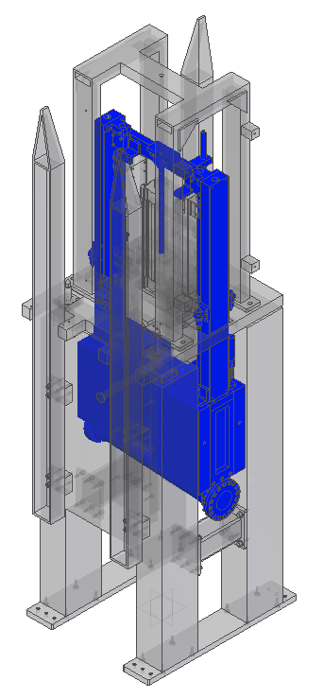
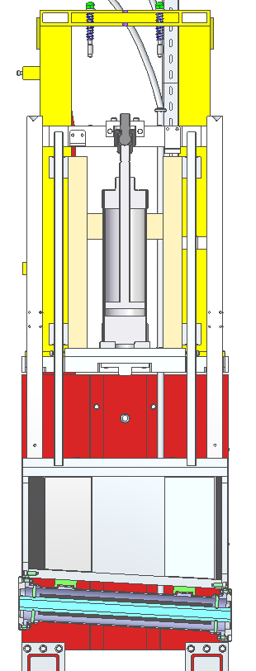
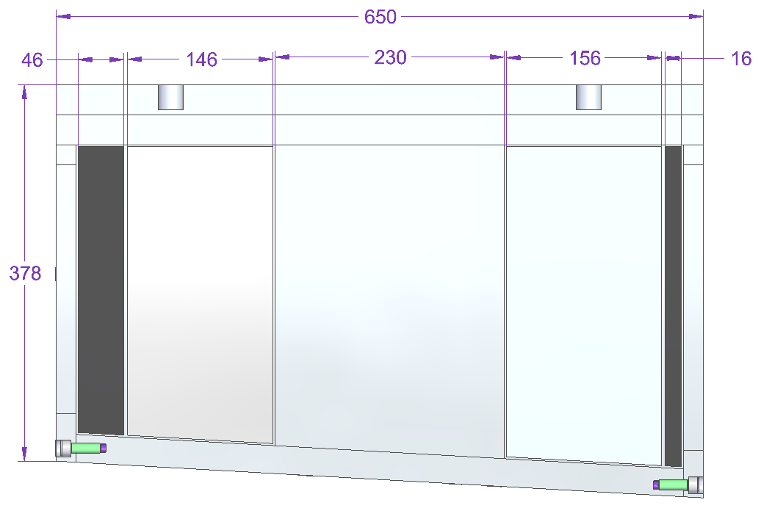
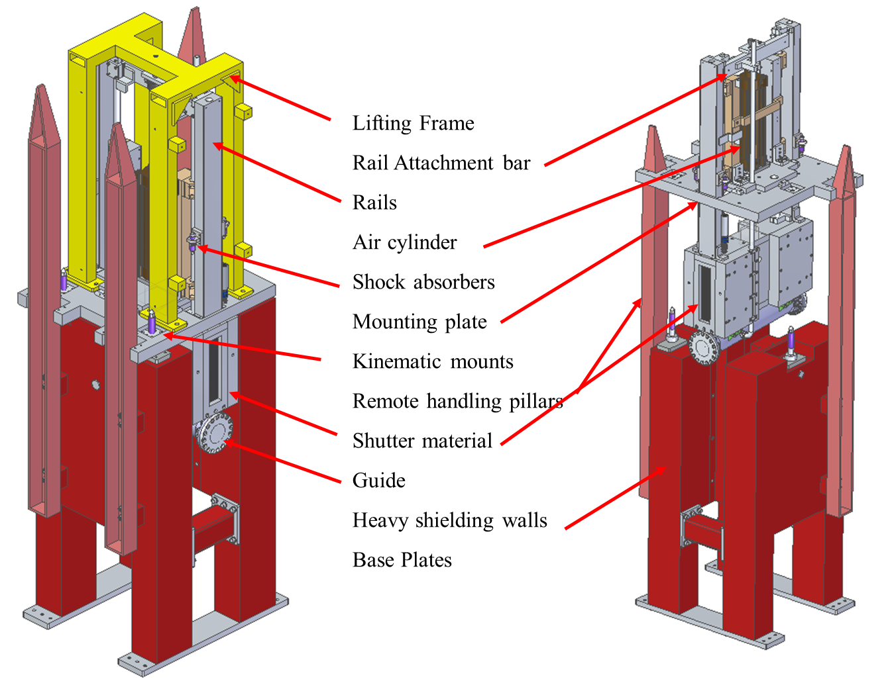
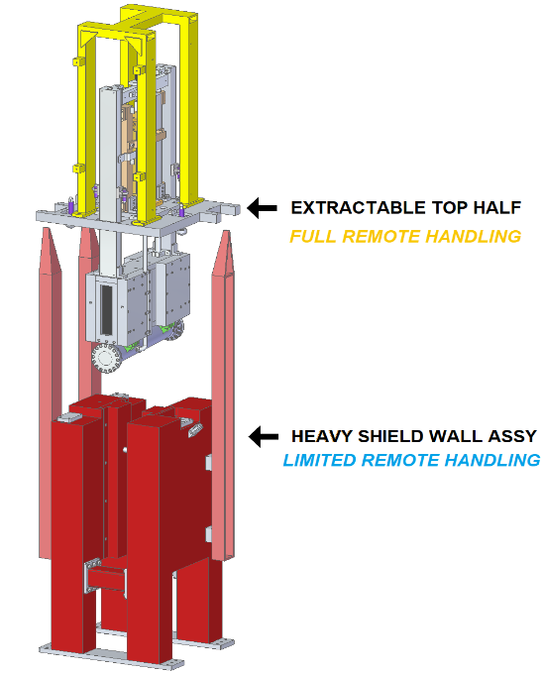
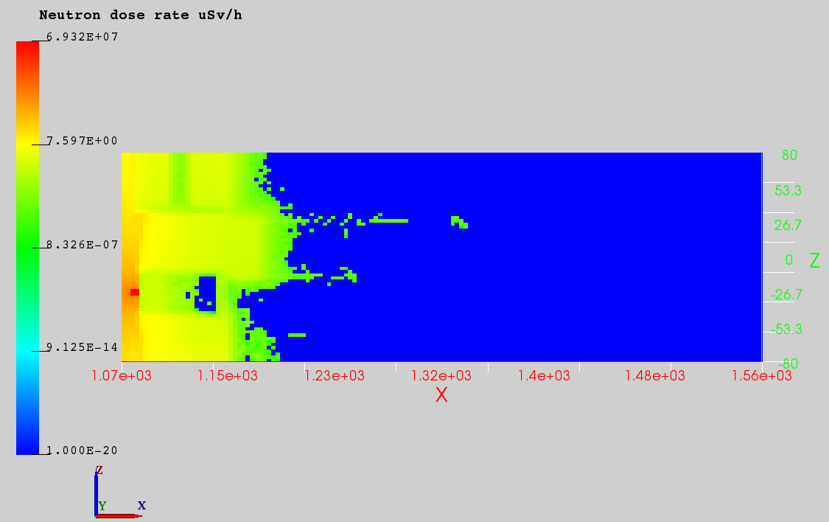
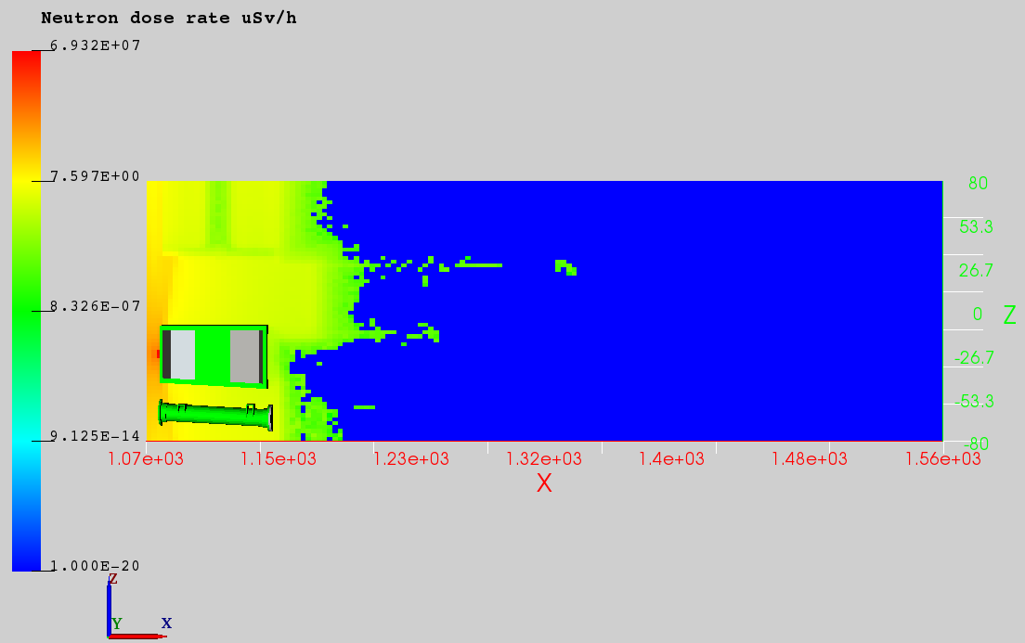
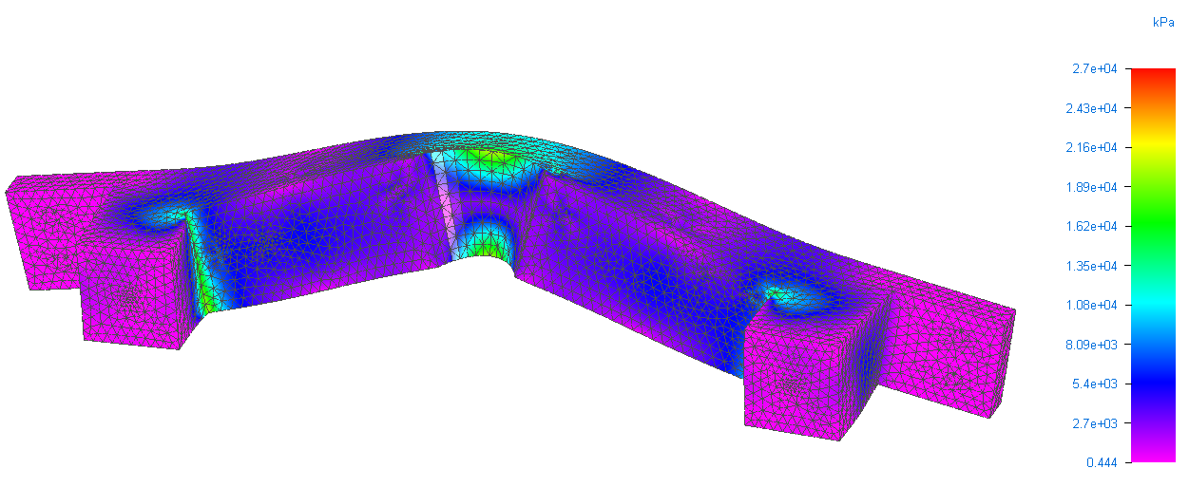
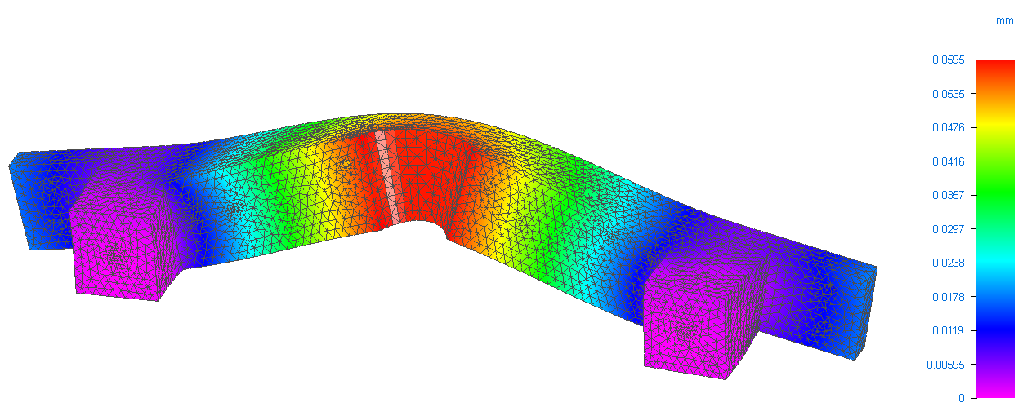
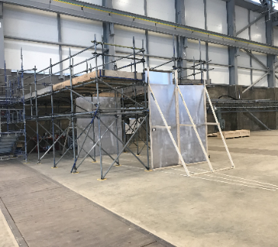
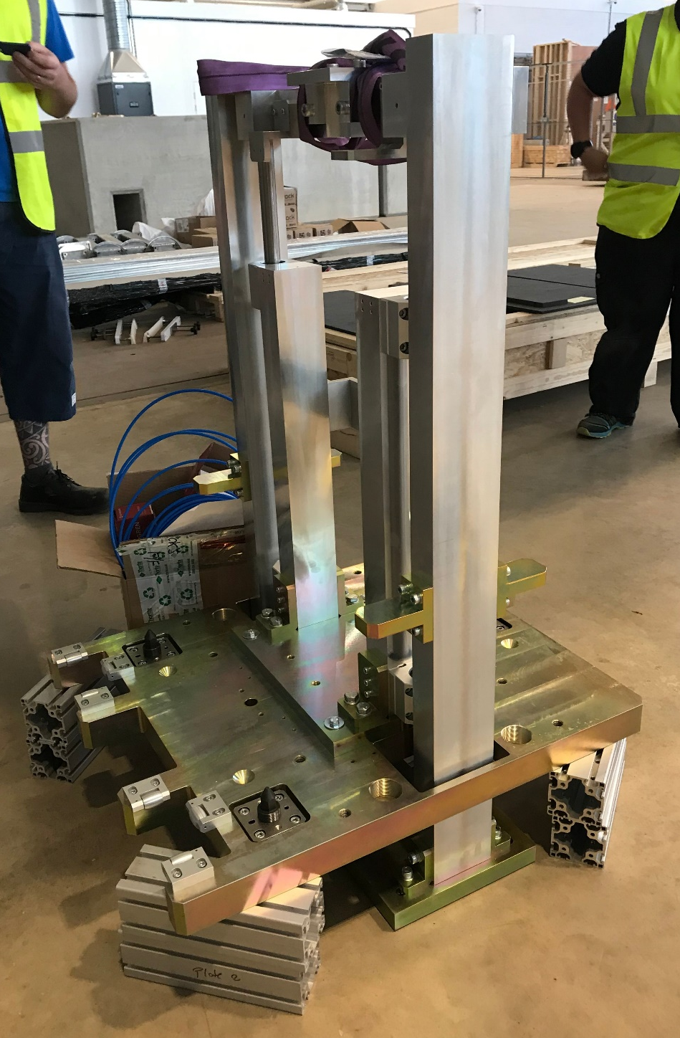
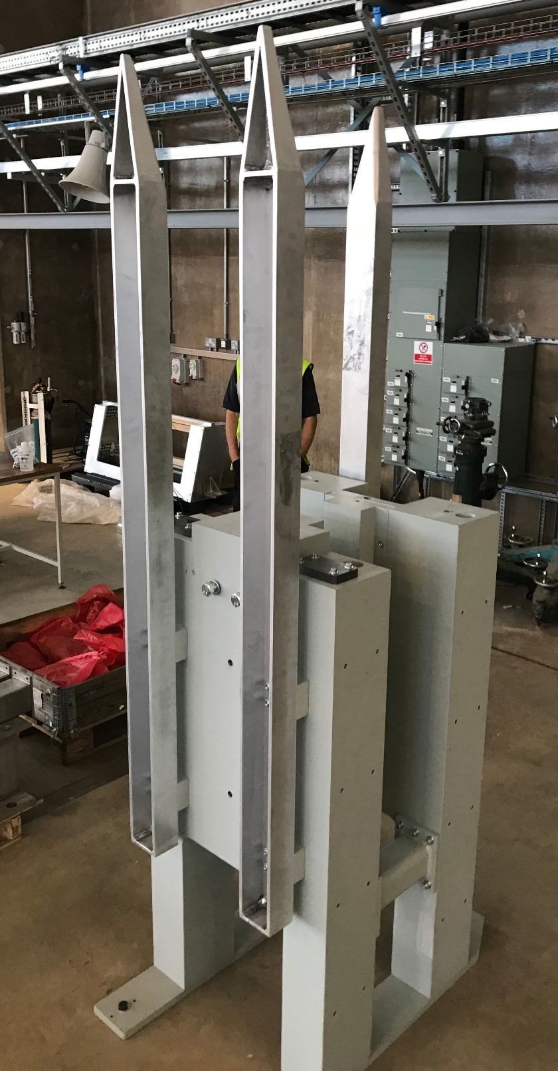
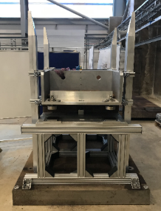
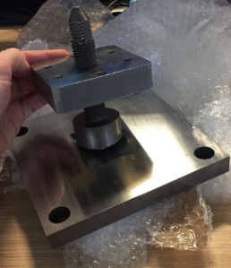
LOKI Heavy Shutter Design
Ben Hicks
ben.hicks@stfc.ac.uk; Rutherford Appleton Laboratory, Harwell Campus, Didcot, OX11 0QX
Background
Scope
LOKI is a Small Angle Neutron Scattering (SANS) instrument designed by STFC for the ESS.
The heavy shutter is a safety device that blocks the neutron beam to allow access to the instrument sample area.
For LOKI, a vertical translating design has been chosen.
Key design aspects include the material composition of the radiation-absorbing beam dump and mechanism for translating.
1m x 0.7m x 3m space envelope.
Pneumatic actuation preferred due to high radiation environment.
Must fail-safe; shutter must close if pressure/power is lost.
Must be easily removable should failure occur.
Repeatability of the mirror guide position must be <100µm, with greater repeatability desired.
Repeatability of the beam dump is less critical.
Key Design Aspects
Location & Operation
Translating System
Shutter Block Material
The basic requirement is a maximum activity of 3µSv/h (microsieverts per hour) inside the cave and it should be possible to approach the shutter after 3 days.
Figure: The heavy shutter is situated in-bunker, directly inside the bunker wall.
Figure: Moving parts shown in blue and cut-out section.
Left-hand side: Shutter up/Beam on. Right-hand side: Shutter down/Beam off.
Beam Direction
A 125mm bore air cylinder moves the beam dump and guide vertically 260 mm. A “hard-stop” is used to accurately position the guide at the top of travel.
Compressed air at 6 bar is required to translate the 400 kg sub-assembly.
B₄C S-DOUGH
AL ALLOY 1XXX
CARBON STEEL
BORATED POLYETHY-LENE
B₄C S-DOUGH
Remote handling
Figure: The beam stop consists of a front layer of born carbide, followed by aluminium, steel, borated poly, and then a final layer of boron carbide.
Due to the highly radioactive environment, it is required that important maintenance can be performed remotely. The entire top sub-assembly can be lifted out and accurately
Material selection was based on previous shutter designs and input and analysis from the neutronics team at ISIS. Neutron and gamma radiation was looked at with the shutter open and closed.
replaced using a crane and the supporting guiding pillars. Three kinematic mounts enable accurate repeatable positioning.
Figure: Diagram of LOKI heavy shutter with labelled parts.
2 main modes of operation.
Open state - Guide beamline section is aligned to the beam, facilitating neutron transport down the beamline.
Closed state - Shutter dump assembly is aligned to the beam blocking neutron transport preventing radiation from continuing down the beamline.
Figure: Heavy shutter with fixed shielding walls and removable top assembly
Figure: Vertical cut of radiation analysis for low energy neutron dose rate
Testing and Modelling
Pre-build
The remote handling system and kinematic mounts have been tested with loading.
• Poor repeatability when dry (Δ0.2mm)
• Good repeatability when lubricated (Δ0.03mm)
Pre-build of the heavy shutter is currently taking place at ISIS. Most key sub-assemblies have been delivered. Due to the large mass (3 tonnes) and size (2.5 m height), a detailed assembly plan is required. Calibration and factory acceptance testing will also be performed before delivery.
Figure: Finite Element Analysis of stress and deformation in rail attachment bar
Engineering analysis has been performed on critical components of the LOKI heavy shutter design. This includes stress and deformation analysis of load bearing parts.
Figure: Remote handling rig and vee kinematic mount
Figure: L to R – Mock bunker area, Shutter block, Moving rails system, heavy shielding walls, lifting frame.
Acknowledgements
Will Halcrow, Gábor Náfrádi, Jim Nightingale, and valued input from colleagues at ESS.

