Slide 1


Shielding a neutron source : a tough job but possible
A.Menelle
LLB CEA-CNRS Saclay
ISNIE Summer school PSI, ch 20/9/2018

Slide 2
Teoretical OUTLINE
What Sylvain Desert ask me to do
Part 1 Theory
  Types of radiation
  Radiation from different sources
  How shielding works
  Shielding materials (for different uses)
  Thickness approximation (Sullivan hand calcs)
  Leak paths
  Activation
Part 2 Engineering consideration
  Cost
  Structural issues (stability/seismic/floor load)
  Disposal
  Construction techniques
  Ease of manufacture
Part 3 Shielding (Low energy) ie out of line of sight (similar reactor – spallation)
  Instrument caves
  Beamline shielding
  Use of materials (cost/performance/ease of use/disposal)
  Applicable Construction techniques (cast in place/blocks)
  Worked example
    Reactor source
    Spallation source

Slide 3
Pratical OUTLINE
What I will do
Part 1 Theory
  Why a shielding ?
  Workers protection regulations
  Blue green yellow orange and red zones
  The different radiations
  Activation example
  Neutron specificity
  Detector protections
Part 2 Engineering consideration
  Basic formulae
  Cross sections issues
  Materials to use
  Transmission / absorption measurements
Part 3 Shielding
  Gamma shielding
  Neutron absorption
  Fast neutron absorption
Part 4 Various
  Other common materials

Slide 4


Why Shielding : workers and detectors cases
Two different jobs for shielding
Shielding for people : enable them to work within authorized dose limits
Shielding for detectors : detect only neutrons scattered from the sample
People protection parameters
Distance
Time of work
Shielding
Classification of people
Detectors protection parameters
Absoption of unwanted particules
Efficiency of detection of unwanted particules by the detectors

Slide 5
Protection of workers : dose limits
May depend a bit on local regulations, though quite homogeneous through europe.
In France, 3 categories of workers on installations with ionizing radiations and their dose limits :
A : 20 mSv/year
B : 6 mSv/year (CEA : <200 μSv/day)
Non classified worker (NE): 1 mSv/year (CEA : 1 μSv/day and dose rates > 10 μSv/h not allowed)
(In a monochromatic beam on the sample in Orphée : 5 Sv/h)
Deal with 2 types of workers
Staff of the installation : B (to give them a specific medical survey)
Users : NE

Slide 6
Protection of workers : zones
Access control and limits will depend on the radiation doses present in the different areas of the buildings
Design buildings and shieldings so that users may have access to what they need as non classsified workers (NE) :
Experiment cabin and cave, pathways and preparation laboratories : blue < 7.5 μSv/h (~200 n/cm²/s)
Equipment necessary for the source operation : green < 25 μSv/h
Zone | Limits | Access
Non exposed | < 0.5 μSv/h | No limitation of access
Blue | < 7.5 μSv/h | Controlled access; no limitations
Green | < 25 μSv/h | Controlled acces with restrictions for NE
Yellow | < 2 mSv/h | Regulated access, no NE
Orange | < 100 mSv/h | Access submitted to authorizations
Red | > 100 mSv/h | Forbidden access

Slide 7
Different type of radiations
To calculate exposition and dose rates, sum up all radiations
Particles that mainly go straight and just transfer their energy
Alpha (⁴He); stopped by a sheet of paper. Danger in case of contamination and internal exposure. Do not allow to drink or eat; access prohibited with open wound; control radioactivity in air.
Beta (e-); stopped by a few mm of any material (metal, glass, plastic, …)
Gamma high energy photon; needs mass to be stopped (lead, tungsten, water, …). ! At high energy, may break a nucleus and expel neutrons !
Neutrons
Low interaction with matter, large mean free path, energetic ones difficult to stop
Bounce on atoms before being absorbed ⇨ random walk : thermal neutrons are like a gas; beware of leaks
Absorption creates activation ⇨ with 25 meV you may obtain 1MeV at a different place and time

Slide 8
Activation example
Air contains 0.9% of ⁴⁰Ar. Under thermal neutron irradiation, you create radioactive ⁴¹Ar with half life 1.8 hour
In Orphée : part of beam of 10⁸ n/cm²/s in air of the 14 instruments create around 10⁵ Bq/h of ⁴¹Ar. If confined and breathed by a user during 15mn, it might create an internal exposure of 1 μSv
ESS Magic : 10⁹ n/cm²/s on sample, create 10⁶ Bq/h, might induce a dose of 10 μSv in 15mn by breathing. This is 10 time the day dose limit for NE in CEA.
Solutions
Avoid air irradiation; put beam under vacuum
Vent the experimental caves
Be prepared to have questions of the safety authorities

Slide 9
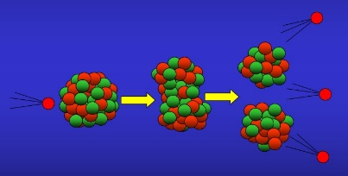
Neutrons specificity
Fission fast neutrons (> 1eV)
Low interaction, low detection, cross everything, no capture, no creation of radio-isotope, low energy deposition, go straight
But
High slowing down interaction with light atoms and goes to thermal neutrons : beginning of pb
Thermal neutrons (< 1eV)
Lots of interactions with atoms, multi bounces, a gaz of neutrons; no leaks is a challenge
lots of activation channels of nearly all atoms, espeacially the heavy ones
To avoid pb : choose carrefully materials to be used and pay a lot of attention to additives or impurities !!!!!!
1 μg of Co in 1g of Si irradiated 1 day with 10¹³n/cm²/s. 1 month later : 0 Bq of Si, but 1352 Bq of ⁶⁰Co with 5.3 year half life. Think of the Pb with 1 ton of shielding !!!!!!!

Slide 10
Shielding for detectors
Long and time consuming efforts to decrease instrument background
My targets :
source on, beam off : 10 times the electronic background
source on, beam on : 100 times the electronic background
Obtained by protection against outside neutrons : shielding of the cave and the detector vessel with neutron absorbers
Special attention for fast neutrons : low efficiency of detection (< 10⁻⁶ for 1 MeV fast neutrons) but always there.
Thermalization with concrete or PEHD
Absorption with Cd of B₄C
Beware of the holes !!!
          Think if it is useful before thermalizing

Slide 11
Shielding for fast neutron
Not to do !
Fast neutrons present between guides 4 and 5
You think that neutrons comes from the reactor
Install a wall of PEHD / B4C to thermalized and absorb them
No change !!!
Neutron dose
before adding a wall
4 μSv/h fast
4 μSv/h thermal
Neutron dose
with the wall
4 μSv/h fast
4 μSv/h thermal

Slide 12
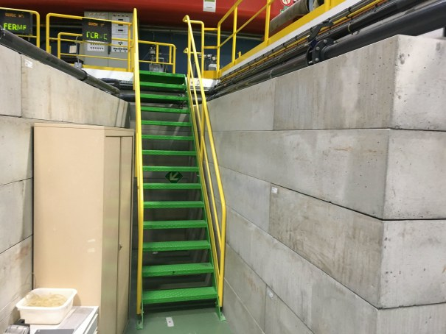
Shielding for fast neutron
To do !
Put absorber (concrete) everywhere !

Slide 13
Shielding for detectors : Theory
Absorbs neutrons coming from outside
Cover the detector vessel and sample vessel with neutron absorbers
Add PEHD outside if too much* fast neutrons around
* : too much depends on the spectrometer. In Orphée, high fast neutron level betwwen G4 and G5 (2.5 μSv/h). Pb for reflectometer, not for powder diffractometer.
Detectors must see only the sample
Use collimators in front of the detector (fixed or moving) : Gd, Cd, B
Put nothing except sample in the neutron beam (windows create neutron scattering)

Slide 14
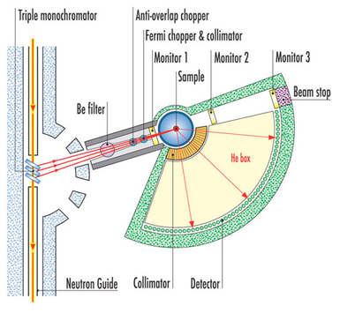
Radial Collimators and beam setup
Shield flight tank with neutron absorber
Avoid anything in the beam in view of detectors
5C1 collimator

Slide 15
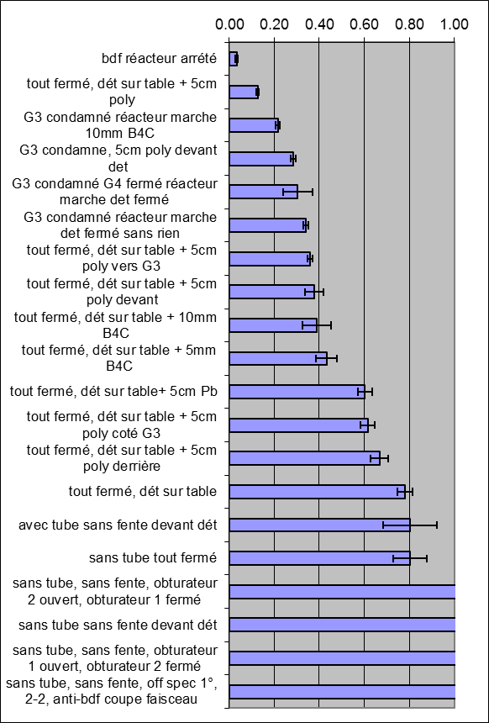
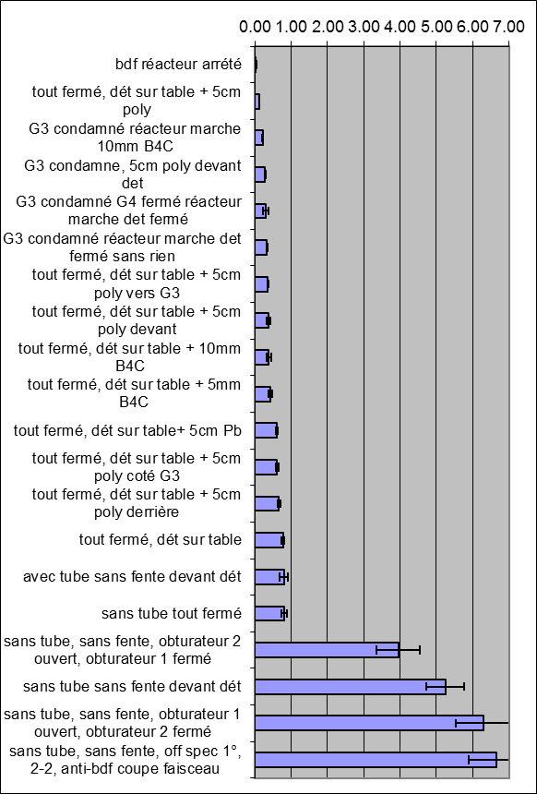
Shielding for detectors :optimization
A long work
Counts/hour/ time channel on a reflectometer
Source off
Electronic noise
Beam off
Different
conditions
Beam on with sample

Slide 16
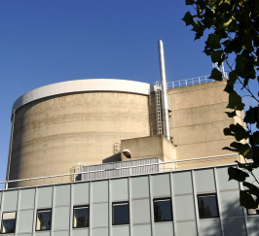
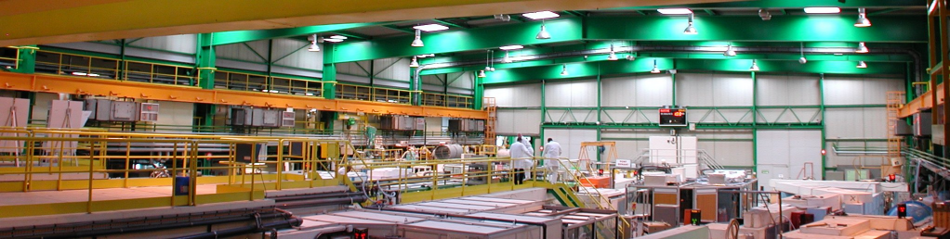
What to use and where ?
Materials for spectrometers
Materials for shieldings
Special materials

Slide 17

Basic formulae
Transmission through a thickness x :
x
t : transmission (absorption a = 1-t )
σ : cross section
ρ : density
x : thickness
For solids :
σ : cross section in barns
ρ : density in g/cm³
x : thickness in cm
M : molar mass in g
Example : 1cm Al
M=27g; σ=0.23barns; ρ=2.7g/cm³
t = 0.986 gives a=0.014
For gases :
σ : cros section in barns
x : thickness in cm
P : pressure in bars
Example : 5 bars ³He on 1cm
: 5333 barns
t = 0.49 gives a=0.51

Slide 18
Which cross section ?
σ_{a} : absorption cross section : prop. to λ
σ_{c} : coherent scattering cross section : constant with λ for λ<λ_{c}
At least a Bragg peak must be there for single crystals
σ_{i} : incoherent scattering cross section : constant
λ_{c} given by 2d sin(θ/2)=λ_{c} with θ=180° scattering angle
for d=2.5Å (max distance between atomic planes) it gives λ_{c}=5Å
Example : Al
σ_{a} = 0.23 barns σ_{c} = 1.495 barns σ_{i} = 0.008 barns
Beware :
Cross sections at 2200 m/s in tables (1.8 Å thermal neutrons)
Correction σ_{a}(λ) : λ* σ_{a} /1.8
λ<λ_{c}
λ<λ_{c}
λ>λ_{c}

Slide 19
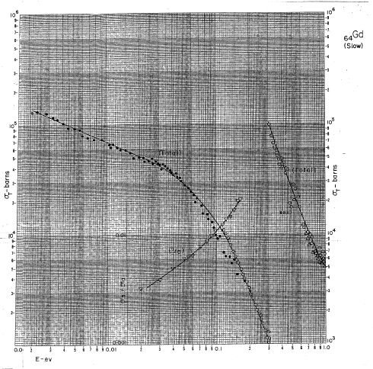
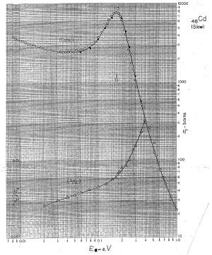
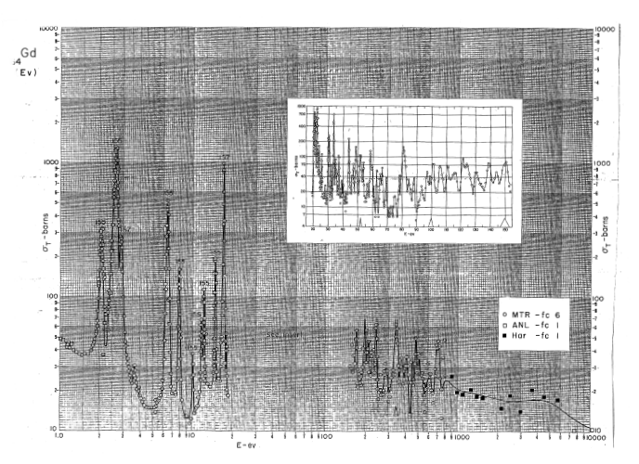
Cross sections variations
Not always prop. to λ
Cd
Gd
Low energy
High energy

Slide 20
Depends of the microstructure
This does not take into account heterogeneities small angle scattering.
Example : porous alumina made by K.Lagrene :
Al₂O₃
σ_{a} = 0.46 barns σ_{c} = 15.68 barns σ_{i} = 0.02 barns
Should be transparent to neutrons
But not at all due to SANS of pores.
Might be reduced if you fill pores with contrast match solvent.

Slide 21
Common materials used on spectrometers
Al (AG3, AG3-net or AG5)
  Light, easy to machine
  Transparent with neutrons
  Low activation (espeacilly for AG3-net), half life Al : 2.24 mn
  Always wait at least 10mn before any Al sample holder manipulation after irradiation: emission of a γ of 0.8 MeV
Steel
  Try to use steel without Co (it activates with a half life of 5.3 year, γ of 1.3 MeV
  Quite absorbing σ_{a} = 2.56 barns
  Strong
Zircalloy (Zr + 2.5% Sn)
  Transparent to neutrons
  High strength, low activation, (emits béta)
  Difficult to find

Slide 22
Other materials
Brass (Cu Zn alloy)
  Easy to machine but
  Zn has high activation; half life 244 days, γ of 1.3 MeV
  To avoid close to the beam
Plastics
  Becomes powder under γ irradiation. γ breaks double links in the molecules
  Highly absorbing because of hydrogen : σ_{i} = 80 barns
  To avoid if high γ dose

Slide 23
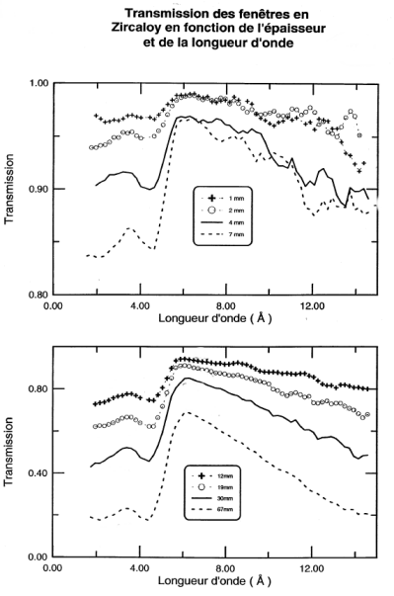
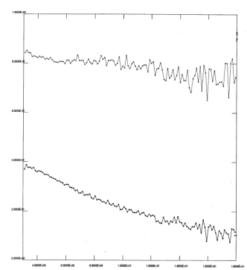
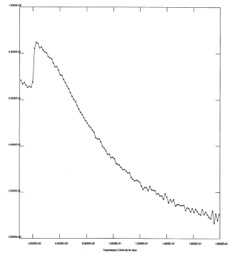
Various thermal neutrons Transmissions
Transmission of Zircalloy windows with thickness and wavelength
1
1
D₂O
Fe
H₂O
18Å
18Å
4Å
0
4Å
0

Slide 24
Gamma radiation protection
To be protected against γ, you have to put mass !
Concrete
  Contain roughly 15% of water (for fast neutrons thermalization)
  Low cost, easy to handle
  Various quality available
    Normal concrete : 2.3 kg/dm³
    Concrete with baryty : 3.6 kg/dm³
    Heavy concrete : usual 4.4 kg/dm³, special 6 kg/dm³, for 2T 7 kg/dm³
  Add absorbing materials for neutrons (B₂0₃) or γ (Fe, Pb, …)
  May be a bit like a cooking receipe (heavy concrete for 2T)
Lead
  Not that expensive, easy to handle and design, available as bricks
  Density : 11.3 kg/dm³
  Beware : transparent to thermal neutrons σ_{a} = 0.2 barns
Tungsten
  Highly absorbing; Density : 19.3 kg/dm³; σ_{a} = 18.3 barns
  Expensive and difficult to machine

Slide 25
Gamma absorbing power

Slide 26
Materials for neutron absorption
High absorption neutron cross section.
Most commonly used :
Li ; σ_{a} = 70 barns (⁶Li ; σ_{a} = 940 barns , !! nuc. mat !!)
B ; σ_{a} = 767 barns (¹⁰B ; σ_{a} = 3835 barns)
Cd ; σ_{a} = 2520 barns
Gd ; σ_{a} = 49700 barns; qq μm are suffisent !
Beware :
Neutron absorption conduct generally to the emission of a high energy particle; usually a γ, sometime a α or a β.
The heavier the absorbing nucleus, the highest number of desexcitation paths with high energy particle emission

Slide 27
Neutron absorption
Gd
  Very efficient absorber
  Emits energetic γ around 0.2 MeV, 1 Mev and 6.5 MeV (use with moderation)
Boral plates (B4C between Al fols)
  Very efficient absorber
  Difficult to machine
  Difficult to find
Cd (metallic foils)
  Emits γ mainly at 0.6 MeV, but also at 6 MeV
  Easy to handle and use
  Need a limited thickness
  Few neutron reflection
  Regulations for handling more and more stric (poison)
B₄C (powder, rubber, plastic, sintered, carbon)
  Difficult to machine, but may be molded and cut
  Emits γ of 0.5 MeV only
  Reflects a bit the neutrons
Boron nitrides (white friable blocs)
  Special for furnaces
  Easy to machine before heating
  Reflects a lot of neutrons
⁶Li (plastic LiF foil or carbonate of Li powder)
  Absorbs without γ emission, but emits a α of 4.5 MeV
  Very expensive, easy to handle, use only in special cases

Slide 28
Neutron absorption : one more fast neutrons Pb
Be carrefull : B and Li emit fast neutrons around 2MeV.
  Efficiency for B : 0.5 10⁻⁶
  Efficiency for Li : 80 10⁻⁶
Be carrefull : high energy γ can extract neutrons from heavy nuclei and can emit fast neutrons
Example : neutrons/Cd/Pb or neutrons/Gd/Pb
  Low efficiency : ~ 10⁻⁸
Detection efficiency of fast neutrons by ³He gaz detectors
  σ_{a} = 0.8 barns; detection efficiency 6 10⁻⁴
  White beam (10⁹n/s) absorbed by Li, emits 8 10⁴n/s
  30 cm² neutron detector at 1 m sees 600 n/s (solid angle)
  Low efficency of detection ⇨ background of 0.4 n/s
  You cannot avoid shielding of fast neutrons !!

Slide 29
Stop fast neutrons
Stop fast neutrons with thermalization !!
Best thermalizer is H atom.
Various solutions tested :
Water tank : leaks Pb
PEHD (CH2)n (easy to handle but will not sustain high flux)
Concrete (15% water inside)
!! Do not forget to put an absorber of thermal neutrons afterwards !!
Slowing down from 2MeV to 0.025eV | H₂O | D₂O
Mean free path (cm) | 0.5 | 2.5
Slowing down distance (cm) | 5.7 | 11
Nb chocs | 18 | 25

Slide 30
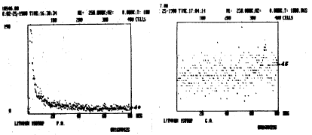
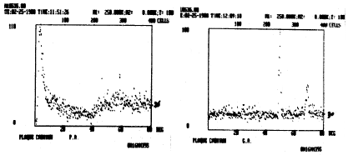
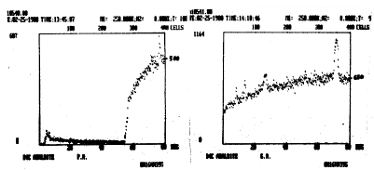
Neutron absorbers and background
All neutrons absorbers reflects more or less thermal neutrons
⁶Li
15mn on G61 | Diffus | Peak
⁶Li | 5 | 5
Cd | 20 | 170
B₄C sintered | 5 | 700
B₄C carbon | 40 | 1800
B₄C plastic | 590 | 1100
Boron nitride | 50 | 10000
Cd
B4C plastic

Slide 31
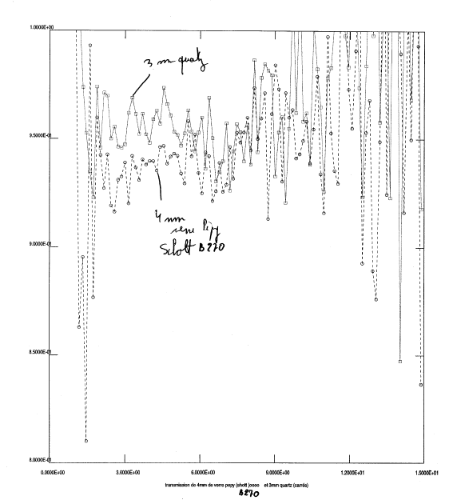
Materials with specific use 1/2
Si
  Large size and low price single crystals (20*20*30 cm³).
  Transparent to neutrons.
  May be used at low and high T°
  A bit fragile
Quartz (Si02)
  Transparent to neutrons and light
  Available on different size
  More expensive than Si
Glasses
  Composition not always known with precision
  Often highly absorbing
  Schott glass B270 quite transparent
  95% transmission after 4mm.

Slide 32
Materials with specific use 2/2
.
Alumina (Al₂O₃)
  Available as single crystal
  Transparent for neutrons
  May be used at high and low T°
Be
  Short wavelength absorber
HOPG graphite filters
  Selective wavelength absorption
Fast neutrons Bi filter
  High mass to stop fast neutrons (209)
  low absorption : σ_{a} = 0.04 barns

Slide 33
Conclusion
Lots of work and tests to be done
Thank you

Slide 34
Glasses for neutron guides
Rôles :
Guider les neutrons
Tenir le vide
Absorber les neutrons
Compositions des verres à guides de neutrons en % en masse
Float Borkron A8866 Borofloat
SiO2 70.62 62 67 83
Al2O3 0.9 0 0.9 2.7
ZnO2 0 11 0 0
Na2O 13.6 7 0.5 3.6
B2O3 0 12.5 19 12.9
CaO 9.8 0 0 0
MgO 3.85 0 0 0
K2O 0.5 0 8.3 0.6
Fe2O3 0.1 0 0 0.001
SO3 0.28 0 0 0
TiO2 0.015 0 0 0
LiO2 0 0 0.9 0
As2O3 0 0 0.2 0
ZrO2 0 0 0 0.05
99.665 92.5 96.8 102.851
Float :
Crée des γ
Peu cher
Surface de qualité
Un peu mou
Pas d’absorption neutrons
Borkron (guides du LLB):
Cher
A polir
Résistant
Borofloat :
Peu cher
Surface de qualité
Peu résistant au rayonnement
A8866 :
Alternative au Borkron, mais trop dur (difficile à polir)

